Slide 1

BEHAVIORAL FINANCE THEORY

Slide 2





PRESENTED BY
Assewer Mezghenni
Business Analytics and Finance Junior Student

Slide 3
PRESENTED BY
Wissal Lourajini
Business Analytics and Finance Junior Student

Slide 4
PRESENTED BY
Karim Hentati
Business Analytics and Finance Junior Student

Slide 5
PRESENTED BY
Tarek Masmoudi
Business Analytics and Finance Junior Student

Slide 6
Introduction: Definition and importance/Historical background
01
Biases and Heuristics: Psychological biasesCommon heuristics
02
Market Anomalies: Bubbles and crashes/Investor psychology's impact
PLAN
03
04
Investment Strategies: Applying behavioral finance/Tools and techniques
Future Trends: Emerging areas / Integration with technology
05
Challenges of behavioral finance and potential solutions
06

Slide 7






Behavioral Finance

Slide 8
Behavioral Finance Overview
Behavioral Finance
Behavioral finance is a field of study that combines psychological theories with conventional economics to explain why people make irrational financial decisions.

Slide 9
Historical Background & Development
Behavioral Finance

Slide 10
1960 - 1970
Behavioral Finance
Initial discussions on anomalies in market behavior began to surface. Psychologists like Amos Tversky and Daniel Kahneman started exploring cognitive biases and heuristics.

Slide 11
1979
Behavioral Finance
Daniel Kahneman and Amos Tversky published their seminal paper on Prospect Theory, which describes how people choose between probabilistic alternatives that involve risk, where the probabilities of outcomes are known.

Slide 12
1980 - 1990
Behavioral Finance
Researchers like Richard Thaler began applying psychological insights to economics, further developing the concept of behavioral economics. Thaler's work on mental accounting, the endowment effect, and other biases played a crucial role in shaping the field.

Slide 13
2002
Behavioral Finance
Daniel Kahneman was awarded the Nobel Prize in Economic Sciences for his work on Prospect Theory, marking a significant milestone in the recognition of behavioral finance.

Slide 14
Importance of Behavioral Finance
Behavioral Finance
Behavioral finance is essential for understanding market dynamics and investor behavior because it addresses the psychological factors that influence decision-making processes. Key reasons for its importance include:

Slide 15
Explaining Market Anomalies
Behavioral Finance
Traditional financial theories often fail to explain anomalies such as market bubbles and crashes. Behavioral finance provides insights into the psychological factors that lead to such phenomena.

Slide 16
Policy Formulation
Behavioral Finance
Behavioral finance informs regulatory policies and interventions designed to protect investors and maintain market stability. For example, recognizing how investors are influenced by framing effects can lead to better disclosure practices.

Slide 17
Investor Behavior
Behavioral Finance
Understanding how cognitive biases like overconfidence, loss aversion, and herd behavior affect investors can help in predicting market trends and improving investment strategies.

Slide 18
Enhanced Financial Models
Behavioral Finance
Incorporating behavioral insights into financial models leads to more accurate predictions and better risk management strategies.

Slide 19




Psychological Biases
LOSS AVERSION
OVERCONFIDENCE
ANCHORING
HERDING

Slide 20
Psychological Biases
OVERCONFIDENCE
ANCHORING
HERDING
LOSS AVERSION
Definition: Investors fear losses more than they value gains, causing irrational investment decisions.
Impact: Leads to holding losing stocks too long and selling winning stocks too quickly.
Real world examples:
Behavioural Finance has emerged as a serious contender to the Efficient Markets Hypothesis in the study of asset pricing and capital markets. A major tenet on which it rests is the investor’s aversion to loss-induced regret and the consequent tendency to hold losing stocks too long and sell winners too soon. Shefrin and Statman (1985) called this ‘the Disposition Effect

Slide 21
Psychological Biases
LOSS AVERSION
ANCHORING
HERDING
OVERCONFIDENCE
Definition: Overconfidence is the tendency of investors to overestimate their knowledge, skills, and ability to predict market movements.
Impact: Leads to excessive trading, under-diversification, and ignoring risks, which can result in poor investment decisions and lower returns.
Real World EXAMPLES :
A study performed by Brad Barber and Terrance Odean in 2001 proved that theoretical models of financial markets built on the assumption that some investors are overconfident yield one central prediction: overconfident investors will trade too much. We test this prediction by partitioning investors on the basis of a variable that provides a natural proxy for overconfidence--gender. Psychological research has established that men are more prone to overconfidence than women. Thus, models of investor overconfidence predict that men will trade more and perform worse than women. Using account data for over 35,000 households from a large discount brokerage firm, we analyze the common stock investments of men and women from February 1991 through January 1997. Consistent with the predictions of the overconfidence models, we document that men trade 45 percent more than women and earn annual risk-adjusted net returns that are 1.4 percent less than those earned by women. These differences are more pronounced between single men and single women; single men trade 67 percent more than single women and earn annual risk-adjusted net returns that are 2.3 percent less than those earned by single women.

Slide 22
Psychological Biases
LOSS AVERSION
LOSS AVERSION
OVERCONFIDENCE
ANCHORING
OVERCONFIDENCE
HERDING
Definition: Herding is the tendency of investors to follow the actions of a larger group, often leading to market bubbles and crashes.
Impact: Can cause irrational market trends, as investors buy or sell assets based on group behavior rather than individual analysis.
Contrarian Investment Strategies:
going against prevailing market trends by buying undervalued assets and selling overvalued ones.7
EG:During a market boom, a contrarian investor might sell overvalued stocks and buy undervalued ones that others are ignoring, anticipating a market correction.

Slide 23
Psychological Biases
LOSS AVERSION
OVERCONFIDENCE
HERDING
ANCHORING
Definition: Anchoring occurs when investors rely too heavily on the first piece of information they encounter (the "anchor") when making decisions.
Impact: Can lead to skewed decision-making as investors fixate on initial prices or benchmarks, ignoring subsequent relevant data.
REAL WORLD EAMPLES:
Anchoring involves relying on an initial piece of information (the anchor) when making judgments or decisions. A classic example in finance is the impact of anchoring on real estate pricing. Research by Northcraft and Neale (1987) found that real estate agents whose sellers provide higher listing prices (anchors) tend to anchor their valuation estimates on those prices, leading to inflated property values and longer time on the market.

Slide 24

Heuristics are mental shortcuts or rules of thumb that people use to simplify complex decision-making processes, allowing them to make judgments quickly and efficiently. However, while these tools can be helpful in saving cognitive efforts and facilitating decision making, they can also result in errors when applied inappropriately.
01
02
03
Mental shortcuts
HEURISTICS
Mental shortcuts
HEURISTICS

Slide 25
Availability:
01
Individuals make decisions solely based on readily available information, without seeking additional information
02
03
Mental shortcuts
HEURISTICS
Mental shortcuts
HEURISTICS

Slide 26
Fram﻿ing:
01
Individuals focus on how information is presented rather than its actual content. For instance, individuals may take risks if information is presented positively, while avoiding risks if presented negatively.
02
03
Mental shortcuts
HEURISTICS
Mental shortcuts
HEURISTICS

Slide 27
Representativeness Heuristic:
01
02
This heuristic involves making judgments about the likelihood of an event based on how closely it resembles a prototype or stereotype. Individuals may use this heuristic to classify objects, people, or events based on how closely they match their mental image of a category, sometimes leading to misjudgments.
03
Mental shortcuts
HEURISTICS
Mental shortcuts
HEURISTICS

Slide 28


Market Anomalies:
Bubbles
Crashes

Slide 29
Market Anomalies:
Bubbles
Definition: Periods of unsustainable price increases, often driven by irrational exuberance.
Examples: Dot-com bubble (2000), Housing bubble (2007-2008).
Characteristics: Rapid price escalation, speculative buying, overvaluation of assets.
Causes: Investor herd mentality, excessive optimism, and lax regulatory oversight.
Crashes

Slide 30
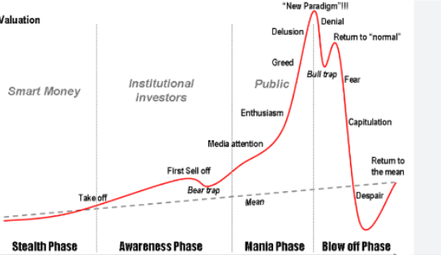
Market Anomalies:
Bubbles
Crashes

Slide 31
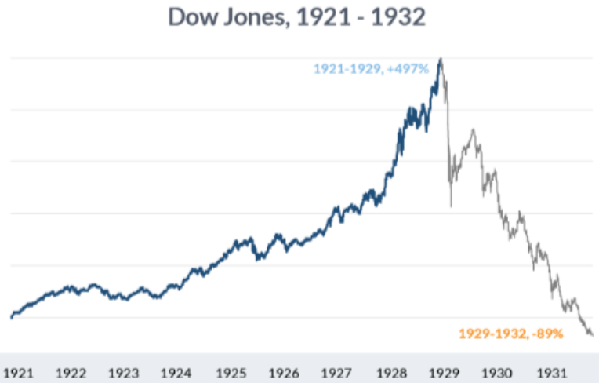

Market Anomalies:
Crashes
Bubbles
Definition: Sharp and sudden declines in asset prices, leading to panic selling.
Examples: Black Tuesday (1929), Black Monday (1987), Global Financial Crisis (2008).
Characteristics: Market panic, rapid sell-offs, liquidity crunch.
Causes: Bursting of speculative bubbles, economic downturns, geopolitical events.

Slide 32

Investor Psychology's Impact
01
02
03
04
Real world examples

Slide 33
Herding Behavior
01
During the dot-com bubble of the late 1990s, many investors followed the trend of investing heavily in internet-related stocks, despite many of these companies having questionable business models and no profits. This herding behavior fueled the rapid escalation of stock prices, eventually leading to the bursting of the bubble.
02
03
04

Slide 34
Fear and Panic Selling
01
During the 2008 Global Financial Crisis, fear gripped the markets as investors panicked in response to the collapse of major financial institutions and the subsequent credit freeze. This panic selling led to sharp declines in asset prices across various markets, exacerbating the severity of the crisis.
02
03
04

Slide 35
Overreaction to News
01
In August 2015, global stock markets experienced significant volatility following China's unexpected devaluation of its currency, the yuan. Investors overreacted to the news, fearing its potential impact on global economic growth. This led to widespread selling, despite the long-term implications being uncertain.
02
03
04

Slide 36
Confirmation Bias
01
Investors often seek information that confirms their existing beliefs and biases, leading them to ignore contradictory evidence. For example, during a bull market, investors may dismiss warnings of an impending downturn and instead focus on positive news that supports their optimistic outlook, potentially amplifying market bubbles.
02
03
04

Slide 37




A
B
C
D
Investment Journals
Setting Investment Rules
Implementing Checklists
Checklist items might include reviewing financial statements, assessing market conditions, and evaluating risk.
Benefit: Reduces emotional influence by promoting thorough analysis.
Education and Training on Behavioral Biases:
Tools for Mitigating Biases
Establishing clear guidelines for buying and selling.
Benifits: Prevents impulsive decisions based on market fluctuations.
EG: Set a rule to sell a stock if it drops 20% from its purchase price.
Commit to investing a fixed amount every month.
Keeping a log of investment decisions and the reasons behind them.
Encourages reflective thinking and helps identify patterns of bias.
Record why you bought or sold a stock and review it periodically.
Continuous learning about common biases and their impact.
Increases awareness and promotes rational decision-making
Example: Workshops or courses on behavioral finance principles and their application.

Slide 38
A
B
C
D
Implementing Checklists
Checklist items might include reviewing financial statements, assessing market conditions, and evaluating risk.
Benefit: Reduces emotional influence by promoting thorough analysis.
Education and Training on Behavioral Biases:
Setting Investment Rules
Investment Journals
Continuous learning about common biases and their impact.
Increases awareness and promotes rational decision-making
Example: Workshops or courses on behavioral finance principles and their application.
Establishing clear guidelines for buying and selling.
Benifits: Prevents impulsive decisions based on market fluctuations.
EG: Set a rule to sell a stock if it drops 20% from its purchase price.
Commit to investing a fixed amount every month.
Keeping a log of investment decisions and the reasons behind them.
Encourages reflective thinking and helps identify patterns of bias.
Record why you bought or sold a stock and review it periodically.

Slide 39

Systematic Rebalancing
Stop-Loss Orders
Value Investing
1
2
3
SUCCESSFUL
INVESTMENT
STRATEGIES
That incorporate behavioral
finance principles
Principle: Overconfidence, Loss Aversion
➔ Regularly rebalancing a portfolio to maintain a desired asset allocation counteracts the tendency to let winning investments grow disproportionately, which can increase risk.
Principle: LOSS AVERSION
➔Automatic sell order at a predetermined price to limit losses,
EG:Buy at $50, set stop-loss at $45 to cap losses at $5 per share.
Principle: Contrarian Strategy, Loss Aversion
➔Selecting stocks that appear to be undervalued by the market. This approach often goes against the market consensus, leveraging the herding behavior of other investors.

Slide 40
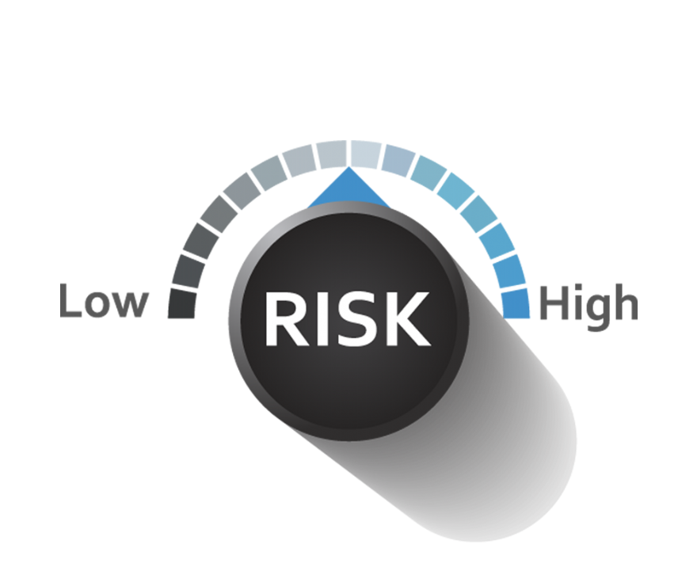



Role of Behavioral Finance
Behavioral finance plays a critical role in shaping how portfolios are managed and assets are allocated by providing insights into how psychological biases affect investment decisions.
Understanding Risk Tolerance
Mitigating Emotional Reactions
Enhancing Decision-Making Processes
Improving Diversification

Slide 41
Role of Behavioral Finance
Understanding Risk Tolerance
Behavioral Insight: Investors’ risk tolerance is often influenced by biases such as loss aversion and overconfidence.
➔ assessing investors’ true risk tolerance, which includes their emotional responses to market fluctuations, portfolio managers can create more suitable asset allocations
Mitigating Emotional Reactions
Enhancing Decision-Making Processes
Improving Diversification

Slide 42
Role of Behavioral Finance
Understanding Risk Tolerance
Improving Diversification
Behavioral Insight: Investors’ risk tolerance is often influenced by biases such as loss aversion and overconfidence.
➔ assessing investors’ true risk tolerance, which includes their emotional responses to market fluctuations, portfolio managers can create more suitable asset allocations
Behavioral Insight: Investors often suffer from familiarity bias, where they prefer investing in well-known companies or local markets.
➔Portfolio managers can counter this by educating investors on the benefits of spreading investments across various asset classes and geographic regions.
➔This reduces portfolio risk and potential biases from concentrated investments.
Mitigating Emotional Reactions
Enhancing Decision-Making Processes

Slide 43
Role of Behavioral Finance
Understanding Risk Tolerance
Mitigating Emotional Reactions
Improving Diversification
Behavioral Insight: Investors’ risk tolerance is often influenced by biases such as loss aversion and overconfidence.
➔ assessing investors’ true risk tolerance, which includes their emotional responses to market fluctuations, portfolio managers can create more suitable asset allocations
Behavioral Insight: Investors often suffer from familiarity bias, where they prefer investing in well-known companies or local markets.
➔Portfolio managers can counter this by emphasizing the importance of diversification and educating investors on the benefits of spreading investments across various asset classes and geographic regions. This reduces portfolio risk and potential biases from concentrated investments.
Behavioral Insight: Emotional reactions, such as panic selling during market downturns or over-investing during bull markets, can harm long-term investment performance.
➔Implementing systematic strategies, such as automated rebalancing, helps mitigate the impact of emotional decision-making.
➔These strategies ensure that investment decisions are consistent and rational, rather than driven by short-term market movements.
Enhancing Decision-Making Processes

Slide 44
Role of Behavioral Finance
Understanding Risk Tolerance
Mitigating Emotional Reactions
Enhancing Decision-Making Processes
Improving Diversification
Behavioral Insight: Investors’ risk tolerance is often influenced by biases such as loss aversion and overconfidence.
➔ assessing investors’ true risk tolerance, which includes their emotional responses to market fluctuations, portfolio managers can create more suitable asset allocations
Behavioral Insight: Investors often suffer from familiarity bias, where they prefer investing in well-known companies or local markets.
➔Portfolio managers can counter this by emphasizing the importance of diversification and educating investors on the benefits of spreading investments across various asset classes and geographic regions. This reduces portfolio risk and potential biases from concentrated investments.
Behavioral Insight: Emotional reactions, such as panic selling during market downturns or over-investing during bull markets, can harm long-term investment performance.
➔Implementing systematic strategies, such as automated rebalancing and dollar-cost averaging, helps mitigate the impact of emotional decision-making. These strategies ensure that investment decisions are consistent and rational, rather than driven by short-term market movements.
Behavioral Insight: Cognitive biases like anchoring can lead to suboptimal investment decisions.
➔Using decision-making tools such as investment checklists can help investors make more objective decisions. By focusing on data and long-term goals rather than short-term market noise, investors are less likely to be swayed by biases.

Slide 45


Future Trends
Behavioral Aspects of Corporate Finance
Sustainable and Ethical Investing
3
1
2
Behavioral finance is a rapidly evolving field that combines insights from psychology and economics to understand how individuals make financial decisions.
These are some Trends and New Research Areas in Behavioral Finance:
Biases: Continued research on cognitive biases (e.g., overconfidence, anchoring, and loss aversion) that affect investment decisions.
Emotional Influences: Exploring how emotions like fear and greed impact trading behavior and market dynamics.
Managerial Decision-Making: Investigating how biases influence corporate decisions such as mergers and acquisitions, capital structure, and dividend policies.
Behavioral Governance: Studying how psychological factors affect corporate governance and the behavior of boards and executives.
ESG Factors: Examining how environmental, social, and governance (ESG) considerations influence investor behavior and market outcomes.
Behavioral Drivers of Sustainable Investing: Understanding what motivates investors to choose sustainable and ethical investments

Slide 46
Financial Markets and Trading:
Public Policy and Regulation:
Marketing and Consumer Finance:
Financial Planning and Advising:
Personalized Financial Advice: Leveraging behavioral insights to provide customized financial advice that accounts for individual biases and preferences.
Improved Financial Literacy Programs: Developing educational programs that incorporate behavioral principles to enhance financial literacy.
Potential Future Developments
and Applications of Behavioral Finance in Various Sectors
Behavioral Policy Design: Designing public policies that use behavioral insights to promote better financial behavior among citizens, such as automatic enrollment in retirement plans.
Regulatory Interventions: Implementing regulations that mitigate the impact of common biases in financial markets.
Behavioral Trading Algorithms: Developing trading algorithms that take behavioral factors into account.
Market Anomalies: Studying the persistence of market anomalies that can be explained by behavioral finance theories.
Behavioral Marketing: Using behavioral insights to design better marketing strategies for financial products.
Consumer Credit and Spending: Understanding how biases affect consumer credit behavior and spending patterns.

Slide 47
Financial Markets and Trading:
Financial Planning and Advising:
Personalized Financial Advice: Leveraging behavioral insights to provide customized financial advice that accounts for individual biases and preferences.
Improved Financial Literacy Programs: Developing educational programs that incorporate behavioral principles to enhance financial literacy.
Public Policy and Regulation:
Marketing and Consumer Finance:
Behavioral Policy Design: Designing public policies that use behavioral insights to promote better financial behavior among citizens,
Regulatory Interventions: Implementing regulations that mitigate the impact of common biases in financial markets.
Behavioral Trading Algorithms: Developing trading algorithms that take behavioral factors into account.
Market Anomalies: Studying the persistence of market anomalies that can be explained by behavioral finance theories.
Behavioral Marketing: Using behavioral insights to design better marketing strategies for financial products.
Consumer Credit and Spending: Understanding how biases affect consumer credit behavior and spending patterns.

Slide 48



Integration of Behavioral Finance with Technology
Fintech Innovations
Big Data and Behavioral Analytics
Blockchain and Cryptocurrencies

Slide 49
Integration of Behavioral Finance with Technology
Fintech Innovations
Robo-Advisors:
Using AI and machine learning to create robo-advisors that incorporate behavioral insights to provide better financial advice.
Personal Finance Apps:
Developing apps that use behavioral nudges to help users save more, invest wisely, and manage their finances better.
Big Data and Behavioral Analytics
Blockchain and Cryptocurrencies

Slide 50
Integration of Behavioral Finance with Technology
Fintech Innovations
Big Data and Behavioral Analytics
Robo-Advisors:
Using AI and machine learning to create robo-advisors that incorporate behavioral insights to provide better financial advice.
Personal Finance Apps:
Developing apps that use behavioral nudges to help users save more, invest wisely, and manage their finances better.
Predictive Analytics:
Using big data to analyze and predict financial behavior based on historical patterns and behavioral theories.
Behavioral Tracking:
Monitoring and analyzing real-time behavioral data to provide instant feedback and interventions.
Blockchain and Cryptocurrencies

Slide 51
Integration of Behavioral Finance with Technology
Fintech Innovations
Big Data and Behavioral Analytics
Blockchain and Cryptocurrencies
Robo-Advisors:
Using AI and machine learning to create robo-advisors that incorporate behavioral insights to provide better financial advice.
Personal Finance Apps:
Developing apps that use behavioral nudges to help users save more, invest wisely, and manage their finances better.
Predictive Analytics:
Using big data to analyze and predict financial behavior based on historical patterns and behavioral theories.
Behavioral Tracking:
Monitoring and analyzing real-time behavioral data to provide instant feedback and interventions.
Behavioral Impacts on Crypto Trading: Studying how behavioral factors influence trading behavior in cryptocurrency markets.
Decentralized Finance (DeFi): Exploring the behavioral aspects of participating in decentralized financial systems.

Slide 52

01
Challenges and Limitations of Behavioral Finance and Potential Solutions
02
03

Slide 53
01
Complexity of Human Behavior:
02
Complexity of Human Behavior: The inherent complexity and variability of human behavior make it difficult to develop universally applicable behavioral models.
03

Slide 54
01
Data Privacy and Ethical Concerns:
02
Data Privacy and Ethical Concerns: Collecting and analyzing behavioral data raises privacy and ethical issues.
03

Slide 55
01
Integration with Traditional Finance:
02
Integration with Traditional Finance: Bridging the gap between behavioral finance and traditional financial theories.
03

Slide 56

Potential Solutions:
Interdisciplinary Research: Encouraging collaboration between economists, psychologists, neuroscientists, and technologists to develop more comprehensive models.
Ethical Guidelines and Regulations: Establishing clear ethical guidelines and regulations for the use of behavioral data.
Educational Initiatives: Enhancing education in behavioral finance to better prepare future financial professionals and policymakers.

Slide 57


